Slide 1

Database Project Halifax Science Library
Presented by:
Bhagya Shree
Madeleine Leong
Mohammad Nawaz
Rishab Gupta

Slide 2
Team Module
Madeleine Leong
Normalization
Create New Tables
Create Mongo collections from given data
Update MySQL tables from the Mongo collections
PHP Web Application
Mapping EER Diagram to Relational Schema
EER Diagram
Bhagya Shree
Rishab Gupta
Mohammad Nawaz
Comparison on Execution Time (MySql vs Db2)

Slide 3




HSL Plans
to sell library items and record information about these sales (transactions) in their database
to record, for each scientific journal (magazine), data about all articles in that magazine
to record data about monthly expenses

Slide 4



Data Requirements
New library items
Customers and Transactions
Monthly Expenses
Books
Magazines
Volumes
Articles
Customer
Transactions
Items
Employee
Employee_Daily_Log
Monthly_Expense
Rent

Slide 5

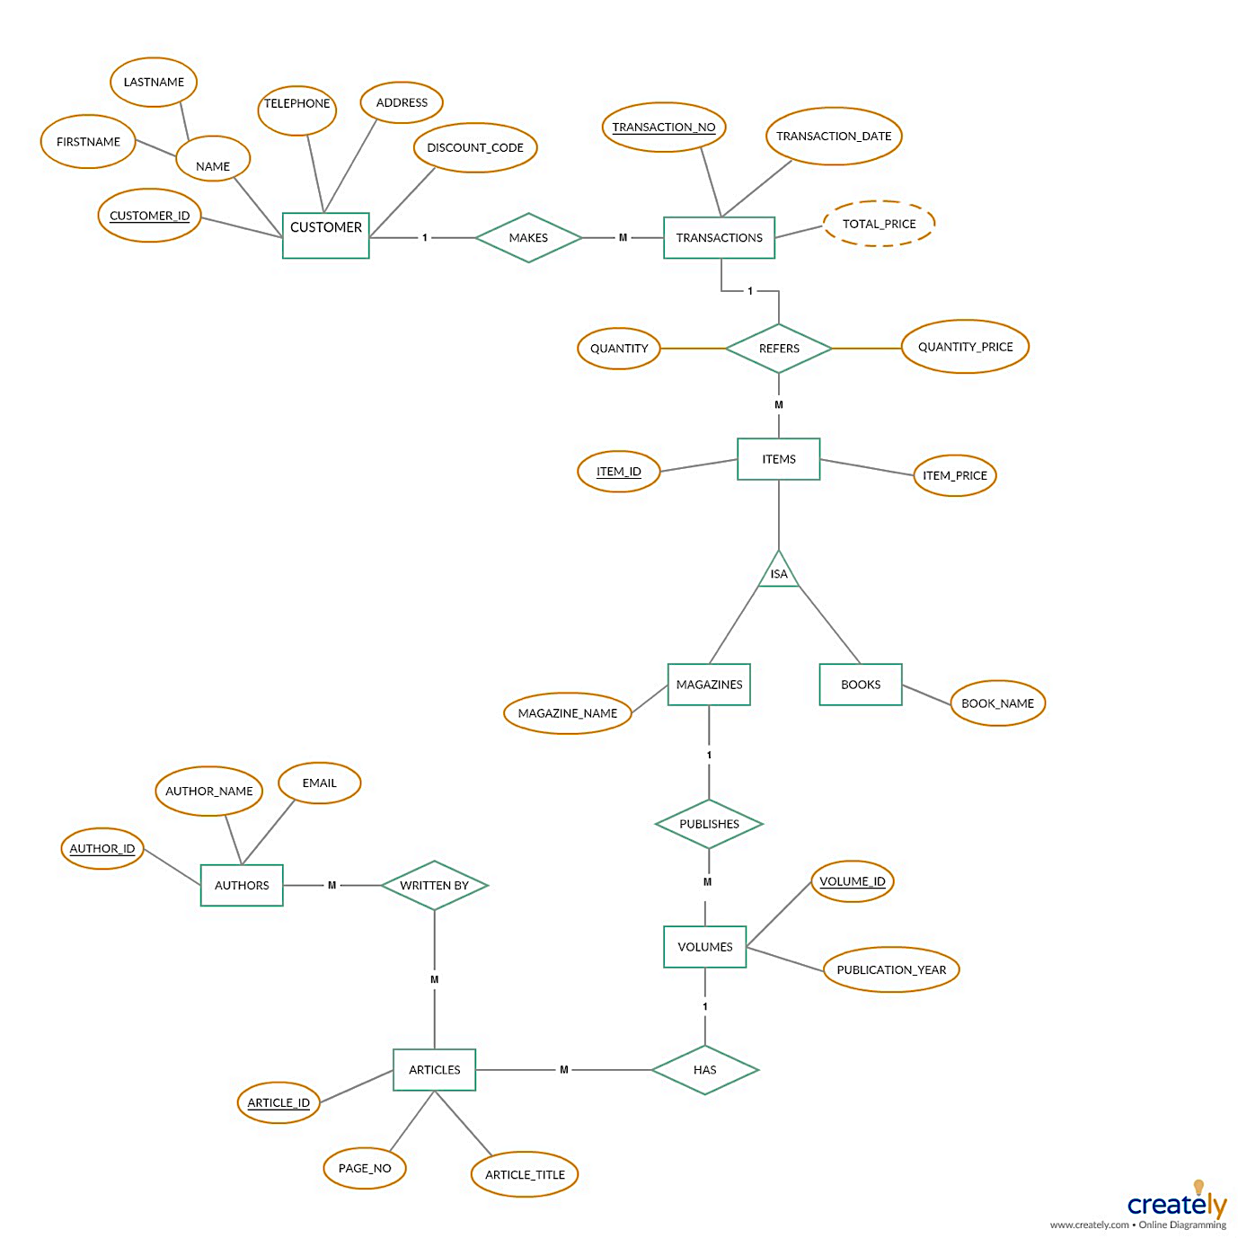
Enhanced Entity Relational Diagram

Slide 6
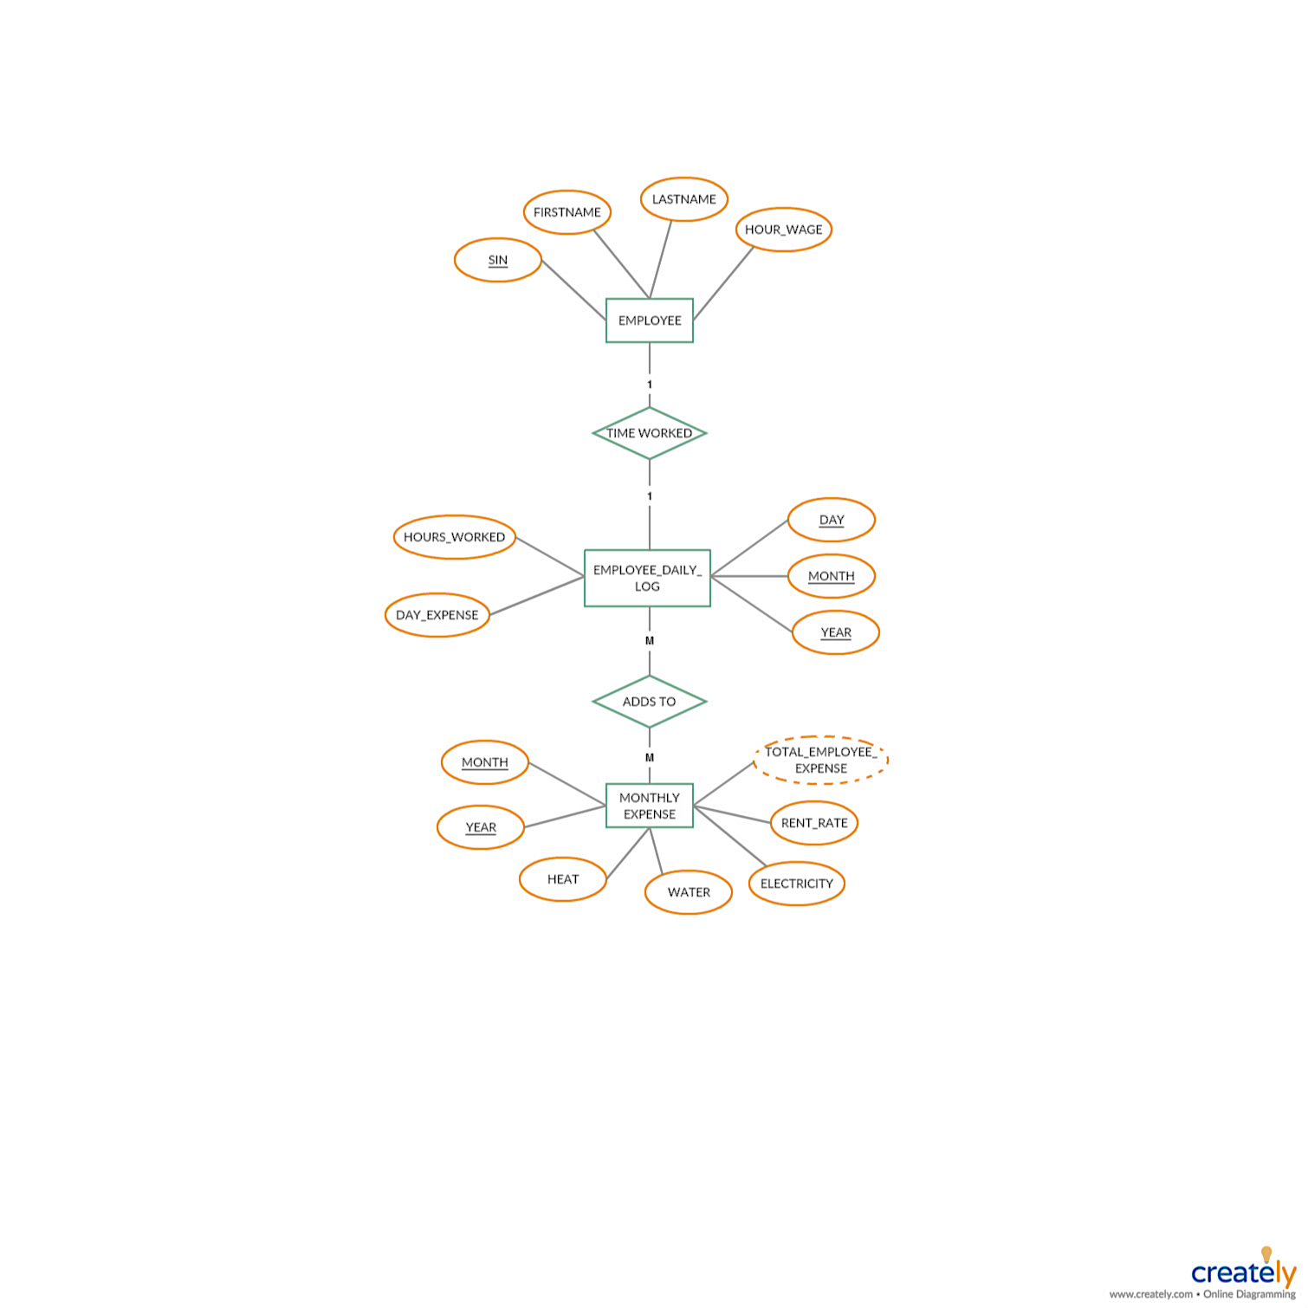
Enhanced Entity Relational Diagram

Slide 7
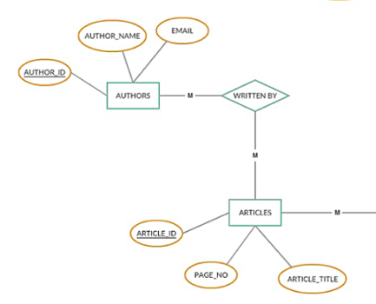
Mapping of EER Diagram to Relational Database
ARTICLE_AUTHOR (Art_Auth_Id, Article_Id, Author_Id)
Foreign Key ARTICLE_AUTHOR (Article_Id) references ARTICLE (Article_Id)
Foreign Key ARTICLE_AUTHOR (Author_Id) references AUTHOR (Author_Id)

Slide 8
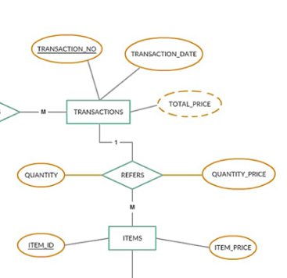
Mapping of EER Diagram to Relational Database
TRANSACTION_ITEM (Tran_Item_Id, Quantity, Quantity_price, Item_Id, Transaction_Number)
Foreign Key TRANSACTION_ITEM (Item_Id) references ITEM (Item_Id)
Foreign Key TRANSACTION_ITEM (Transaction_Number) references TRANSACTION (Transaction_Number)

Slide 9
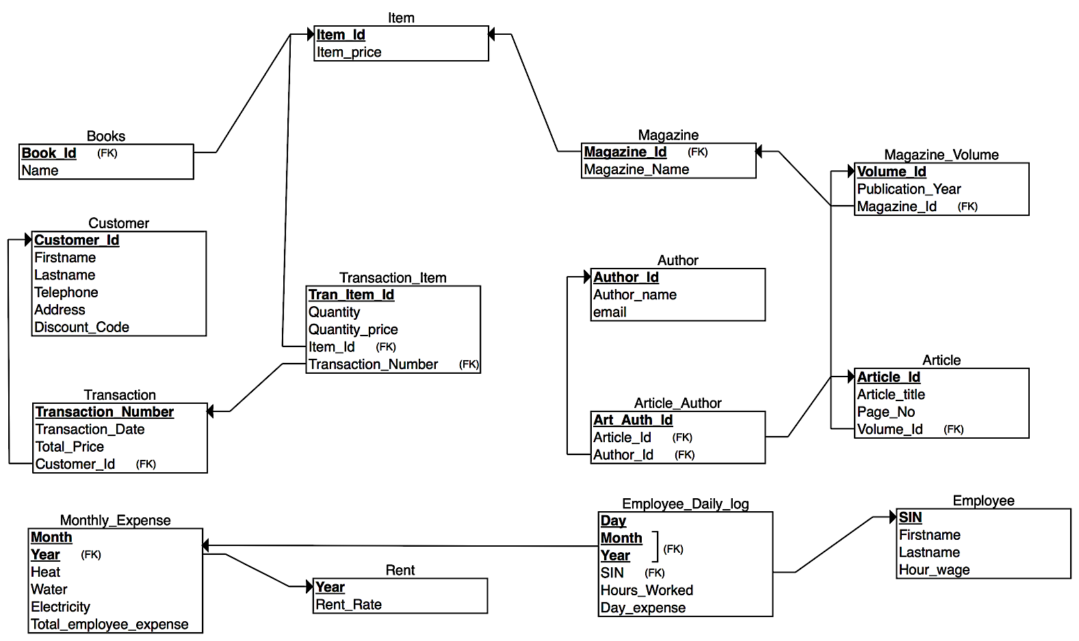
Mapping of EER Diagram to Relational Database

Slide 10
Why Our Database Design is better?
Semantics of the Attributes
Reducing the redundant value in tuples
preventing update, insertion and deletion anomalies
Reducing null values in tuples
Disallowing spurious tuples

Slide 11
Normalization (3NF & BCNF)
Transaction
Transaction_Number
Transaction_Date
Total_Price
Customer_Id (FK)
Customer
Customer_Id
Lastname
Telephone
Address
Discount_Code
Firstname

Slide 12

Create New Tables
Existing Tables
AUTHOR
MAGZINE
ITEM
New Tables
LIBRARY
BOOKS
MAGAZINE_VOLUME
ARTICLE
ARTICLE_AUTHOR
TRANSACTION
TRANSACTION_ITEMS
CUSTOMERS
EMPLOYEE
EMPLOYEE_DAILY_LOG
RENT
MONTHLY_EXPENSES

Slide 13
Create Mongo Collections from Given Data
Data2Mongo Bash Script
Run MySql Script
Existing Table
New Table
Author Mongo Collection
Create AUTHOR Mongo Collection
Import author json file into AUTHOR collection
Article Mongo Collection
Create a TEMPARTICLE mongo collection
Write an articleparse.js to import required information for ARTICLE Collection

Slide 14
Update MySQL Tables from the Mongo Collections
Export AUTHOR and ARTICLE to csv file
Write Python scripts to segregate the csv file into multiple csv files to match our relational database schema
The resulting csv files are imported into the MySQL Database using bash script
Mongo2Sql Bash Script
Library Database

Slide 15
PHP Web Application
Show table
Add new article
Add new customer
Add new transaction
Cancel transaction
Main Page
Library Database

Slide 16
Comparison on Execution Time
Query | MySql Workbench 8.0 CE | IBM Db2 Warehouse on Cloud
SELECT | 0.00156672s | 0.04s
INSERT | 0.031s | 0.04s
DELETE | 0.015s | 0.027s
INNER JOIN | 0.015s | 0.056s

Slide 17
References
Docs.mongodb.com. (2018). mongoexport — MongoDB Manual. [online] Available at: https://docs.mongodb.com/manual/reference/program/mongoexport/#bin.mongoexport
Stack Overflow. (2018). append new row to old csv file python. [online] Available at: https://stackoverflow.com/questions/2363731/append-new-row-to-old-csv-file-python
IBM DB2 Warehouse Tutorial Videos. Available at: https://www.youtube.com/playlist?list=PLo4y_OQEqhGgwwhIJLxBrwFt8b3jYeg4v
JavaScript Tutorial. Available at: https://www.w3schools.com/js/
MySQL Select Statment in PHP with Variables - WebDeveloper.com Forums. 2018. MySQL Select Statment in PHP with Variables - WebDeveloper.com Forums. [ONLINE] Available at: https://www.webdeveloper.com/forum/d/176981-mysql-select-statment-in-php-with-variables
PHP mysqli_num_rows() Function. 2018. PHP mysqli_num_rows() Function. [ONLINE] Available at: https://www.w3schools.com/php/func_mysqli_num_rows.asp
Informal Design Guidelines for relational schema. Available at: http://www.idc-online.com/technical_references/pdfs/information_technology/Informal_design_guidelines_for_relational_schema.pdf

